Slide 1
Investigation of low-speed electrodynamic bearing in BiVAD application
Arthur Thompson Johnson
axt4093@rit.edu
Notes:
This is a presentation on some of the work I have done during this past summer co-op with Dr Day. I designed built and tested several scale model electrodynamic bearings for use in a ventricular assist device, heart pump. I will go over general concepts and Then I will talk about design considerations and experimential validation of the bearings.

Slide 2
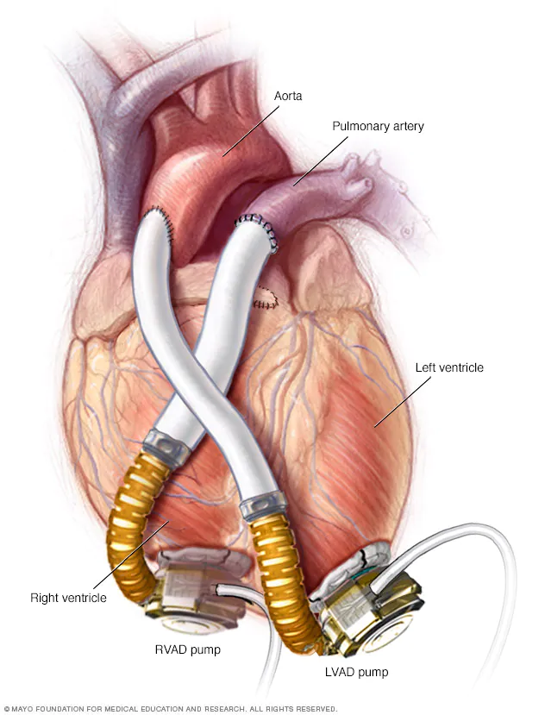
Ventricular Assist Device
Implantable mechanical pump
Rotating pump
Diaphragm pump
5 L/min
Why?
waiting for heart transplant
Ineligible for heart transplant
Aid healing of heart
Left ventricular assist device [LVAD]
Right ventricular assist device [RVAD]
Bi ventricular assist device [BiVAD]

Slide 3
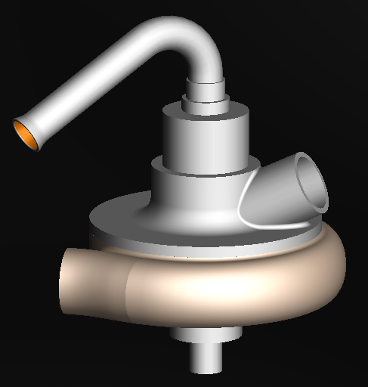
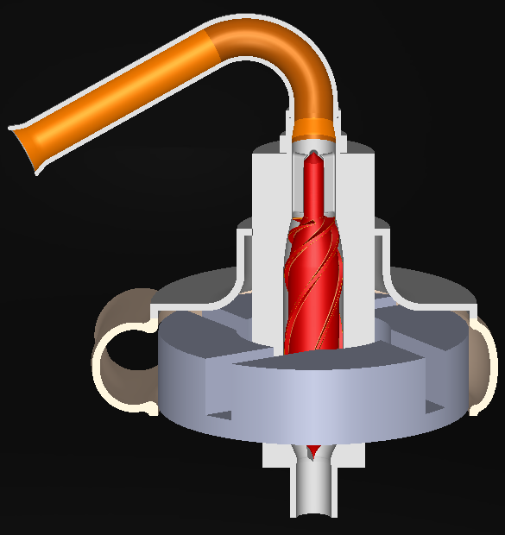
“Dragon heart” BiVAD
Drexel university / RIT
Magnetically levitated / magnetic bearings
Rotary pump
Axial pump inside of a centrifugal pump

Slide 4
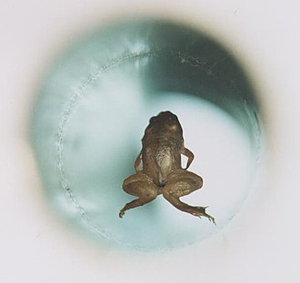
Magnetic Levitation
Why?
No contact
No wear
Zero induced blood damage
Larger gap for blood flow
Less shear induced blood damage
How?
Permanent magnets
Electromagnets
Superconductors
Electrodynamics
Notes:
There are several mechanisms of magnetic levitation,
Magnetic repulsion and attraction of permanentmagnets
Passing current through a wire
Superconductive materials
Electrodynamic lenz law
The next 4 slides describe each of these

Slide 5
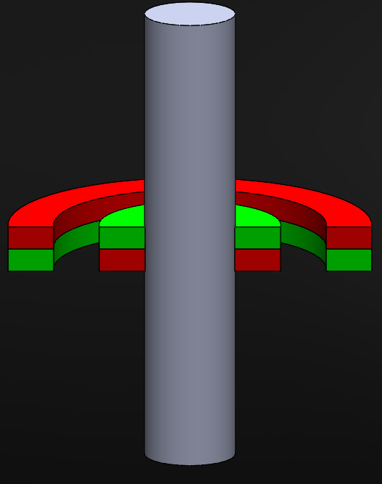
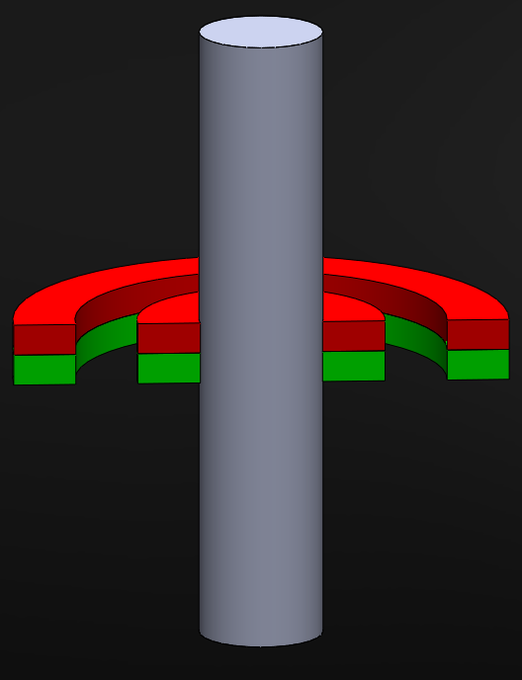
Permanent magnetic bearing
Static levitation in all DOF can not be achieved
Passive bearings, require no current or control
Used in tandem with other bearings
Stiffness in one direction means negative stiffness in another
Notes:
All passive bearings have one thing in common. According to the Earnshaw theorem they are unstable in at least one direction.

Slide 6
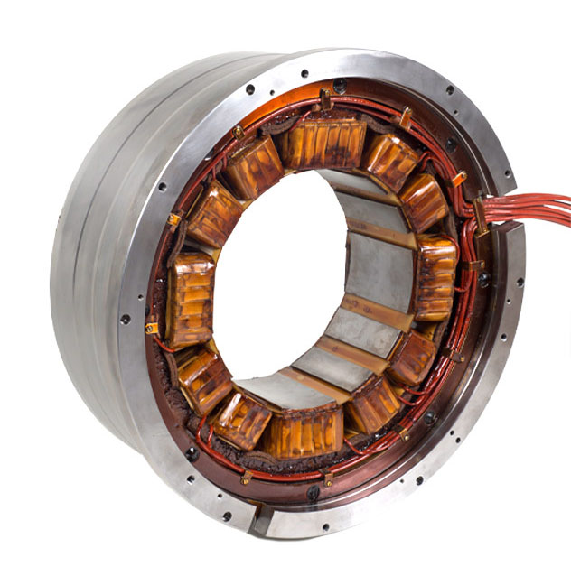
Active magnetic bearing
Requires active control
High power consumption
Expensive
Notes:
Coils modulated by control of sensors

Slide 7
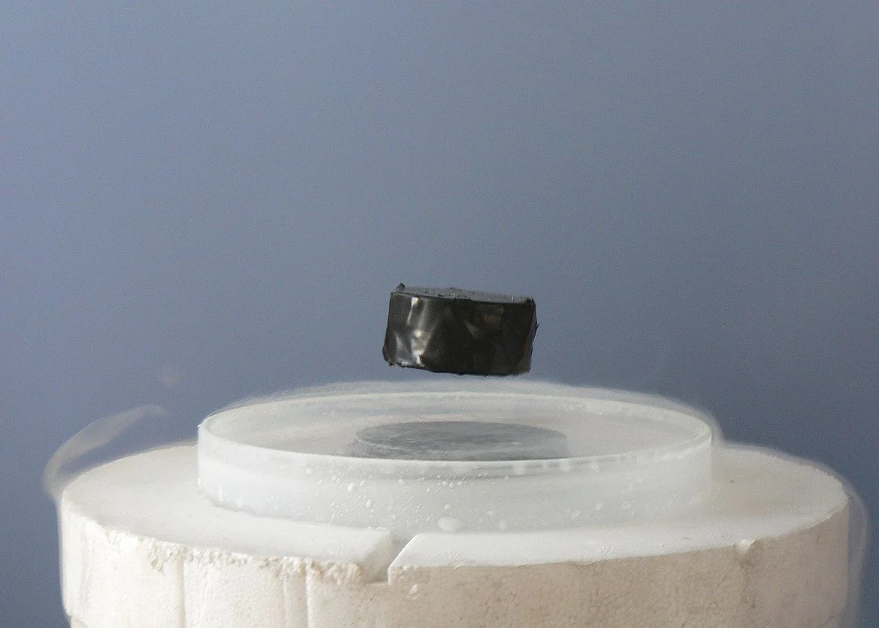
Superconducting bearings
Requires no control
Most efficient of all bearings
Must be kept extremely cold
Expensive
Notes:
the Meissner effect which makes the superconductor act like a perfect diamagnet.

Slide 8
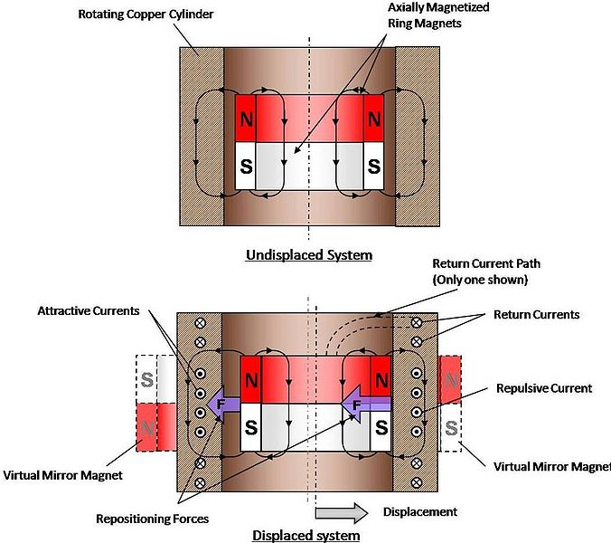
Electrodynamic Bearings
Requires no control
Consumes little power
Cheap
little industry use
Lenz law
Null flux
Notes:
Electrodynamic bearings operate on the mirrored magnetic field effect produced by induction described by Lenz’s Law
“the direction of the electric current which is induced in a conductor by a changing magnetic field is such that the magnetic field created by the induced current opposes changes in the initial magnetic field.”
This effect results in a passively stable bearing above a critical speed. Under this critical speed the bearing behaves as a damper. The maximum force is generated at an infinite speed.
Electrodynamic bearings have seen very little industry application.
Typically suited for extreme high speed angular rotation 15 -100,000 rpm there is some literature and experiential validation of using the lenz effect EDB at lower speeds, even levitation at 1000 rpm with proper damping.

Slide 9
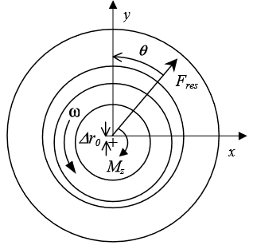
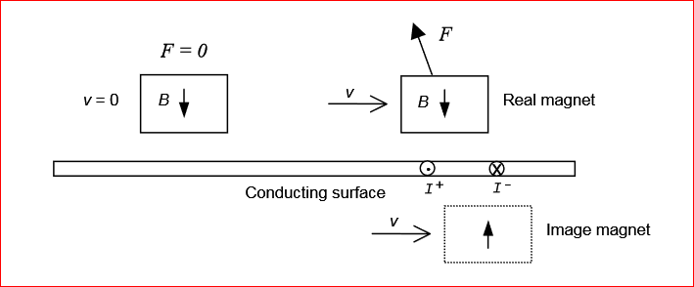
Lenz’ law
Repulsive force
Orthogonal force
Brake torque
Notes:
Lenz law means that any changing electromagnetic flux will be reflected by a conducting surface, thus giving rise to repulsive forces.
The force generated by the induced eddy currents can be described by two vector components and a torque, the repulsive force parallel to the displacement which serves to center the bearing, and the orthogonal force which tends to put the rotor into a whirl, and the brake torque acting against direction of rotation. The orthogonal force can be related to the resistance of the conductor and is undesirable as it decreases stability of the bearing.
the brake torque increases power consumption of the bearing, experimentally it has been less than 25mW.
the mirror is incomplete and phase shifted due to the finite speed and the resistance in the conducting plate. The phase shift changes the angle of the resultant force F so that there is also a brake force component. The force F acts between the magnet and the induced currents, but can also be calculated as the force between the real magnet and its image,

Slide 10
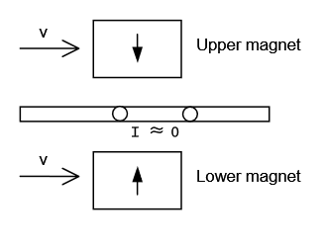
Null Flux Scheme
Homopolar
Heteropolar
Notes:
To minimize the break torque there are several techniques. Concepts of which are all variations of the “Null Flux Scheme”, an arrangement of magnets that do not induce any currents until the bearing is displaced and then are needed [fig 3]. “Homopolar”, axially opposed magnets that cancel each other's flux, thus again inducing no current until displaced. “Heteropolar”, radial sections of magnets coupled to a coiled inductor coiled in such a way that the force generated on one side is cancelled by the other until displacement occurs.

Slide 11
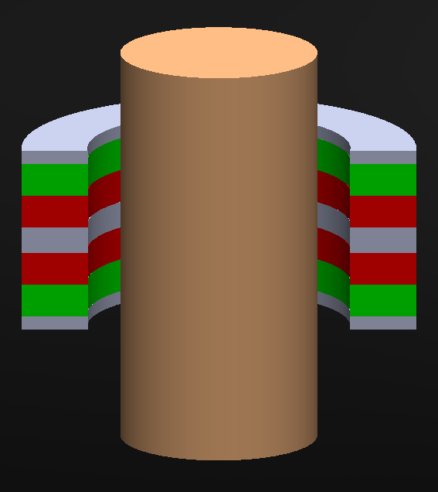
Homopolar
Axially magnetized opposing magnets
Iron shoes to direct flux
Copper cylinder with thickness of at least one skin depth
Notes:
To minimize the break torque there are several techniques. Concepts of which are all variations of the “Null Flux Scheme”, an arrangement of magnets that do not induce any currents until the bearing is displaced and then are needed [fig 3]. “Homopolar”, axially opposed magnets that cancel each other's flux, thus again inducing no current until displaced. “Heteropolar”, radial sections of magnets coupled to a coiled inductor coiled in such a way that the force generated on one side is cancelled by the other until displacement occurs.

Slide 12
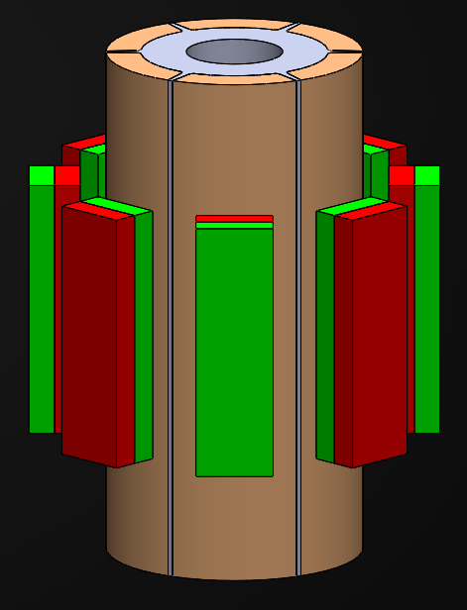
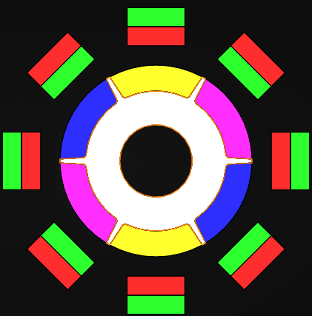
Heteropolar
Diametrically wound coils
Radially magnetized opposed
magnets
Notes:
heteropolar , diametrically wound coils, 2 phases in stator 3 in rotor.
Tightly wound coil, thickenss should be greater than 1 skin depth due to air volume inherent to coil.
Noise levels from rotor have higher amplitude than the resultant forces, the noise is due to rotor imbalances inherent in a hand wound rotor, and low forces are because the magnetic cross section is smaller than it should be, and volume of copper is much less than 1 skin depth.

Slide 13
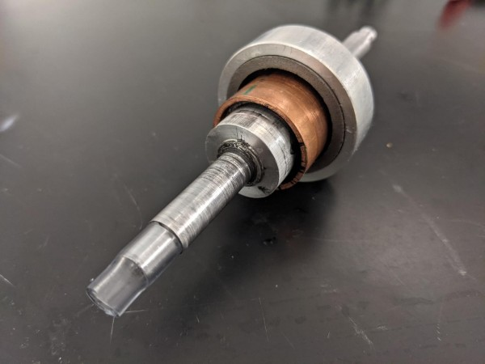
Homopolar bearing attempt 1
Small magnetic volume
High noise due to rotor instability
Low stiffness ~ 0.5 N/mm
Notes:
heteropolar , diametrically wound coils, 2 phases in stator 3 in rotor.
Noise levels from rotor have higher amplitude than the resultant forces, the noise is due to rotor imbalances inherent in a hand wound rotor, and low forces are because the magnetic cross section is smaller than it should be, and volume of copper is much less than 1 skin depth.

Slide 14
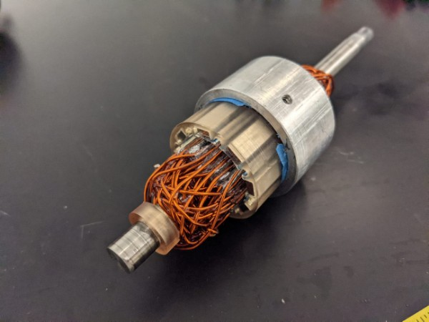
Heteropolar bearing
High rotor imbalances
Low forces due to small magnetic volume & not enough copper
Difficulties winding diametrically wound coils
Unable to get good data due to high noise
Notes:
heteropolar , diametrically wound coils, 2 phases in stator 3 in rotor.
Noise levels from rotor have higher amplitude than the resultant forces, the noise is due to rotor imbalances inherent in a hand wound rotor, and low forces are because the magnetic cross section is smaller than it should be, and volume of copper is much less than 1 skin depth.
Goal of heteropolar bearing was increase stiffness at low speeds, due to more rapidly changing magnetic field induced in copper.
Next steps have been to the goal of increasing stiffness at low speeds, to do this i could reduce resistivity of the rotor material, or increase the rate of change of magnetic flux in the conductor. the former is impractical as cryogenic superconductive materials would not go well in ones chest, I have started experiments in heteropolar bearings. Which are composed of many alternating magnetic poles.

Slide 15
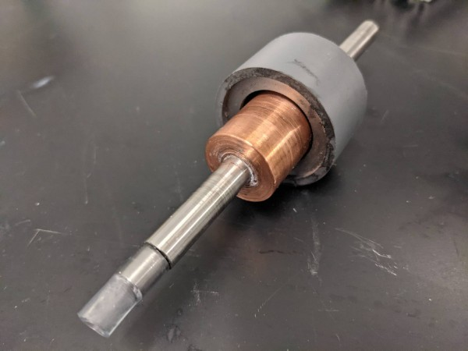
Homopolar bearing attempt 2
More powerful and larger magnets
Well balanced rotor
Appreciable stiffness
Notes:
heteropolar , diametrically wound coils, 2 phases in stator 3 in rotor.
Noise levels from rotor have higher amplitude than the resultant forces, the noise is due to rotor imbalances inherent in a hand wound rotor, and low forces are because the magnetic cross section is smaller than it should be, and volume of copper is much less than 1 skin depth.

Slide 16
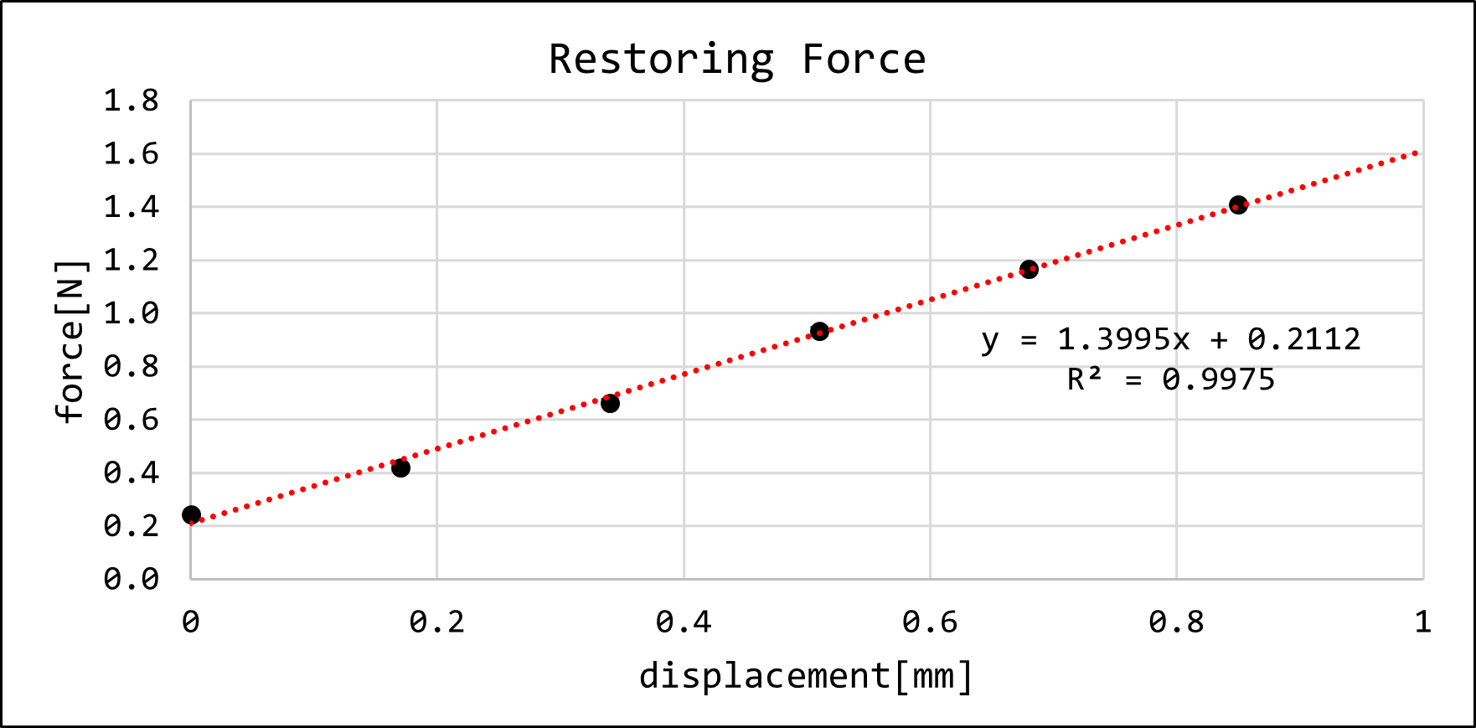
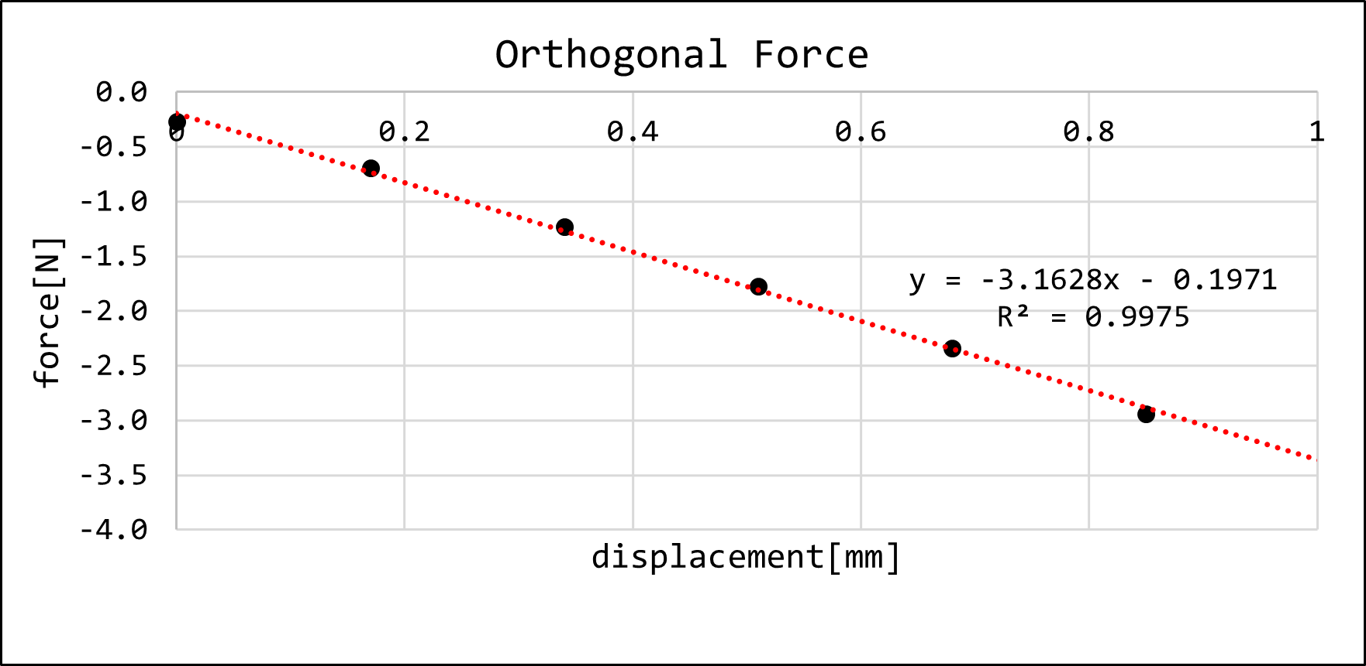
Homopolar bearing 2 DATA
9000 RPM
Restoring stiffness of 1.4 N/mm
Bearing centers with sufficient damping (held in hand)
Experimental power consumption of 24 mW
Notes:
heteropolar , diametrically wound coils, 2 phases in stator 3 in rotor.
Noise levels from rotor have higher amplitude than the resultant forces, the noise is due to rotor imbalances inherent in a hand wound rotor, and low forces are because the magnetic cross section is smaller than it should be, and volume of copper is much less than 1 skin depth.

Slide 17
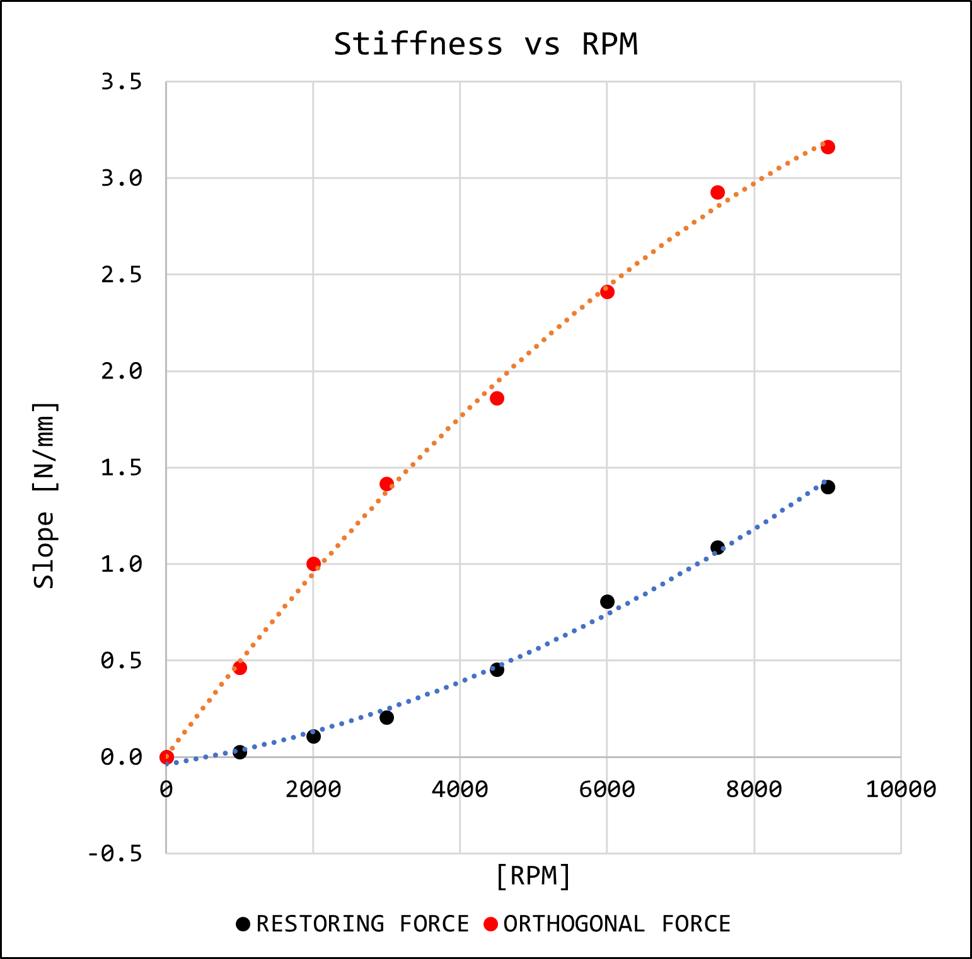
Homopolar bearing 2 Stiffness vs RPM
In operating RPM of pump negligible useful stiffness
At higher speeds restoring force passes orthogonal force
Notes:
heteropolar , diametrically wound coils, 2 phases in stator 3 in rotor.
Noise levels from rotor have higher amplitude than the resultant forces, the noise is due to rotor imbalances inherent in a hand wound rotor, and low forces are because the magnetic cross section is smaller than it should be, and volume of copper is much less than 1 skin depth.

Slide 18
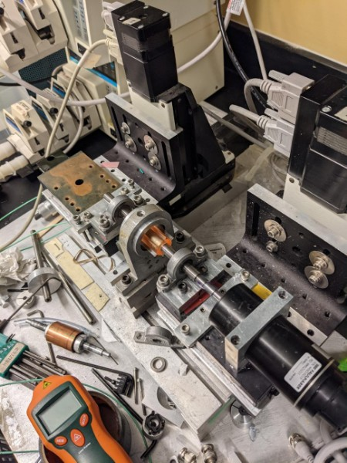
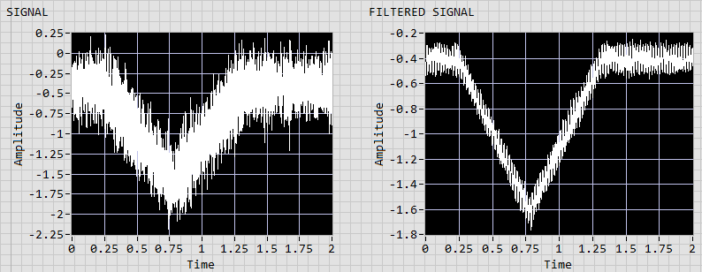
Magnetic Bearing Test Rig [MBTR]
Controlled displacement
Piezoelectric force transducer
Coupled BLDC motor
Notes:
QUARTZ force sensor for measuring the three orthogonal components of a dynamic force
Bldc motor 9000rpm

Slide 19
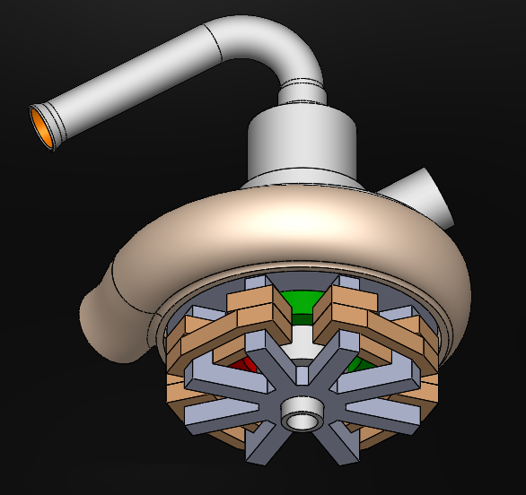
Conclusion / next steps
At low operating speed of BiVAD centrifugal pump there is little application of a homopolar Electrodynamic bearing.
Further research into heteropolar bearings could be done. Proper balancing rig made
Design and analytical analysis of combined electrodynamic active magnetic bearing/motor is underway
Notes:
QUARTZ force sensor for measuring the three orthogonal components of a dynamic force
Bldc motor 9000rpm

